Slide 1
To be updated
Executive Summary
Sales: September billed sales were 294.8 GWh, 2.5 GWh (−0.8%) below budget and 6.9 GWh (−2.3%) below prior year, as lower RT40, RT50 and RT70 demand, including Jamalco self-generation, outweighed higher Residential and RT20/SME sales.
YTD sales of 2,429.0 GWh remain 35.3 GWh (+1.5%) above budget but 120.9 GWh (−4.7%) below prior year. Residential (+29.0 GWh), RT20/SME (+14.5 GWh) and RT70 (+21.2 GWh, narrowing as Jamalco moves to self-generation) remain favorable to plan, while RT40 (−15.1 GWh) and RT50 (−14.6 GWh) are below budget, with RT50 affected by lower hotel demand.
Non-fuel Revenue: September non-fuel revenue was US$31.3M, US$1.2M (+3.9%) favorable to budget, supported by a favorable sales mix, with higher-yield Residential and SME volumes above plan despite total sales 0.8% below budget.
Full-year non-fuel revenue is forecast at US$354.0M, US$13.5M above budget, based on sales approximately 49.2 GWh (+1.5%) above plan, led by Residential and SME demand.
EBITDA: September EBITDA was US$25.7M, exceeding budget by US$4.5M (+21.5%), driven by the reversal of post-Hurricane Melissa heat rate losses following approval of the force majeure application, along with favorable non-fuel and other operating revenue, partially offset by higher O&M expenses.
Full-year EBITDA is projected at US$244.2M, US$1.3M (+0.5%) favorable to budget, with higher non-fuel revenue and Q4 heat-rate and Guaranteed Standards recoveries expected to offset O&M pressures from parametric insurance, lower labour capitalization and FX impacts.
Net Income: September net income was US$9.1M, exceeding budget by US$5.4M, driven by higher EBITDA (+US$4.5M), lower depreciation (+US$2.0M), lower net financing costs (+US$1.2M), and higher other income (+US$0.6M), partially offset by higher taxation (−US$3.0M).
Full-year net income is projected to be $52.3M, $7.1M above budget, driven primarily by higher Other Income from increased Hurricane Melissa insurance proceeds (+$6.2M), lower depreciation (+$4.8M), favorable EBITDA (+$1.3M) and lower financing costs (+$0.8M), partly offset by higher taxation (−$6.0M).
1
Jamaica Public Service | Sept 2026 Corporate Performance Report

Slide 2
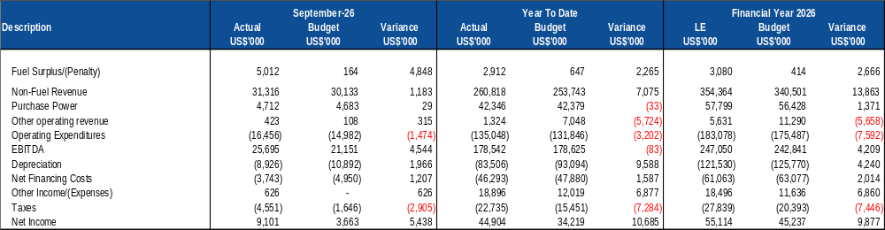
Financial Overview (JPS Standalone)
Net income YTD was US$44.9M, US$10.7M above budget, driven primarily by:
Lower depreciation of US$9.6M, reflecting project delays, lower capital expenditure and the timing of amortization of Hurricane Melissa-related expenditure.
Higher other income of US$6.9M, mainly from Hurricane Melissa insurance settlement proceeds, inventory sales and rental income from transmitter sites.
Lower net financing costs of US$1.6M, primarily from favorable FX movements.
Partly offset by higher income taxes of US$7.3M, largely due to insurance proceeds above budget.
Full-year net income is projected at US$52.3M, US$7.1M above budget, supported by favorable insurance proceeds and lower depreciation, partly offset by higher income taxes.
2
Jamaica Public Service | Sept 2026 Corporate Performance Report

Slide 3
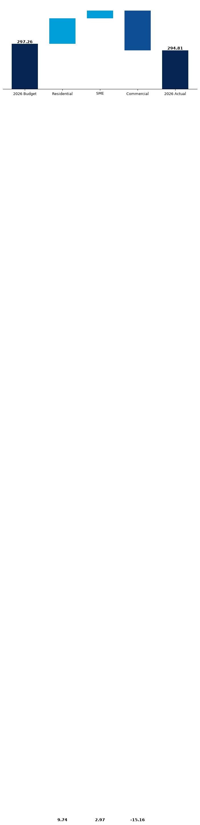
Sales Performance – September 2026
September sales below plan as RT40, RT50 and RT70 demand fell; YTD remains above budget.
Residential and SME gains partly offset lower commercial sales, with RT40, RT50 and RT70 driving the monthly variance.
SEPTEMBER PERFORMANCE
September sales were 2.5 GWh (−0.8%) below budget and 6.9 GWh (−2.3%) below prior year, as lower RT40, RT50 and RT70 demand outweighed Residential and SME gains.
Residential and SME were 12.7 GWh above budget combined, while Commercial was 15.2 GWh (−11.2%) below plan.
Jamalco grid consumption was 0.8 GWh in September, against approximately 9.1 GWh in July, as self-generation came fully online, leaving RT70 4.2 GWh below budget and 8.6 GWh below prior year.
HIGHLIGHTS
YTD sales remain 35.3 GWh (+1.5%) above budget but 120.9 GWh (−4.7%) below prior year. Eleven months after Hurricane Melissa, the prior-year gap remains, although September performance is also being shaped by Jamalco’s move to self-generation.
RT70 remains 21.2 GWh above budget YTD (25.4 GWh at August), but the shift in Jamalco demand is expected to reduce this favorable position over the remainder of the year.
RT40 and RT50 remain below plan YTD by 15.1 GWh and 14.6 GWh, respectively, with RT50 affected by lower hotel demand. September RT40 includes a billing credit of about 1.6 GWh on one account, which is a timing item.
FULL MONTH BILLED SALES
COMMERCIAL SALES
YTD SALES
294.8 GWh
119.6 GWh
2,429.0 GWh
−2.5 GWh vs Budget
−0.8%
−15.2 GWh vs Budget
−11.2%
+35.3 GWh vs Budget
+1.5%
−6.9 GWh vs September 2025
−2.3%
−13.5 GWh vs September 2025
−10.2%
−120.9 GWh vs Jan-Sep 2025
−4.7%
SEPTEMBER SALES BRIDGE
SEPTEMBER RATE-CLASS VARIANCE
Actual vs Budget (GWh)
Variance to Budget (GWh)
3
Jamaica Public Service | Sept 2026 Corporate Performance Report

Slide 4
Cash Flow Forecast (2/2)
  Unrestricted cash is forecast to close December 2026 at approximately $48.1M, supported by $9.4M in dividend income, $7.8M in GCT reimbursements, $17.3M in Hurricane Melissa insurance proceeds and $50.0M in external financing anticipated across October to December.
  September receipts exceeded forecast by US$14.9M, mainly because the forecast excluded GCT. Future forecasts now include GCT.
  Fuel disbursements were US$5.6M above forecast, mainly due to higher Petrojam fuel prices.
  IPP disbursements were US$12.7M above forecast, mainly due to catch-up payment to NFE under the contractual five-day payment terms.
  Payroll and related cash payments were US$0.5M below forecast, mainly due to lower remittances of employee deductions.
  Supplier and contractor payments were US$3.3M below forecast due to deferred settlements.
  Insurance payments were US$0.9M above forecast due to earlier-than-forecast settlements.
  July and August EDF movements include payment of the EDF-funded portion of the annual parametric insurance premium, net of regular monthly contributions.
4
Jamaica Public Service | Sept 2026 Corporate Performance Report

